Slide 1
Catapult Dataset
Jen Sheng Wong,
Rakshit Gogia,
Evan Koerschner

Slide 2
Overview
Goal: To determine best position a player should play in based on data collected from Catapult
Process:
Understanding Dataset
Hypothesis
Data Cleaning
Exploratory Data Analysis
Modeling
Review

Slide 3
Dataset
August 2016 - September 2018
Catapult Wearable Devices
GPS, Inertial, Player Load
31 unique players

Slide 4
Position Descriptions
Forwards: Very fast, quick reflexes, stay on offensive end
Midfielders: In great shape, run the most, help on offense and defense
Backs: Stay in the defensive zone, side to side movements, aggressive
Goalkeepers: Stay in goal circle, very little movement

Slide 5
Hypothesis
"Total Player Load" gives us the best prediction of a player’s positions
Believed that certain positions require different levels of work
Players capable of putting in more work perform better in certain positions

Slide 6
Data Cleaning
Started with 21168 rows of data
# drop useless features
df.drop(['Period Number', 'Date_obj', 'Start Time', 'End Time', 'Day Name', 'Month Name'], axis=1, inplace=True)
# relabel target
df.loc[df['Position Name'] == 'Forward/Mid', 'Position Name'] = 'Mid/Forward'
# filter out bad high speed distance
df = df[(df["High Speed Distance"] < 1000)]

Slide 7
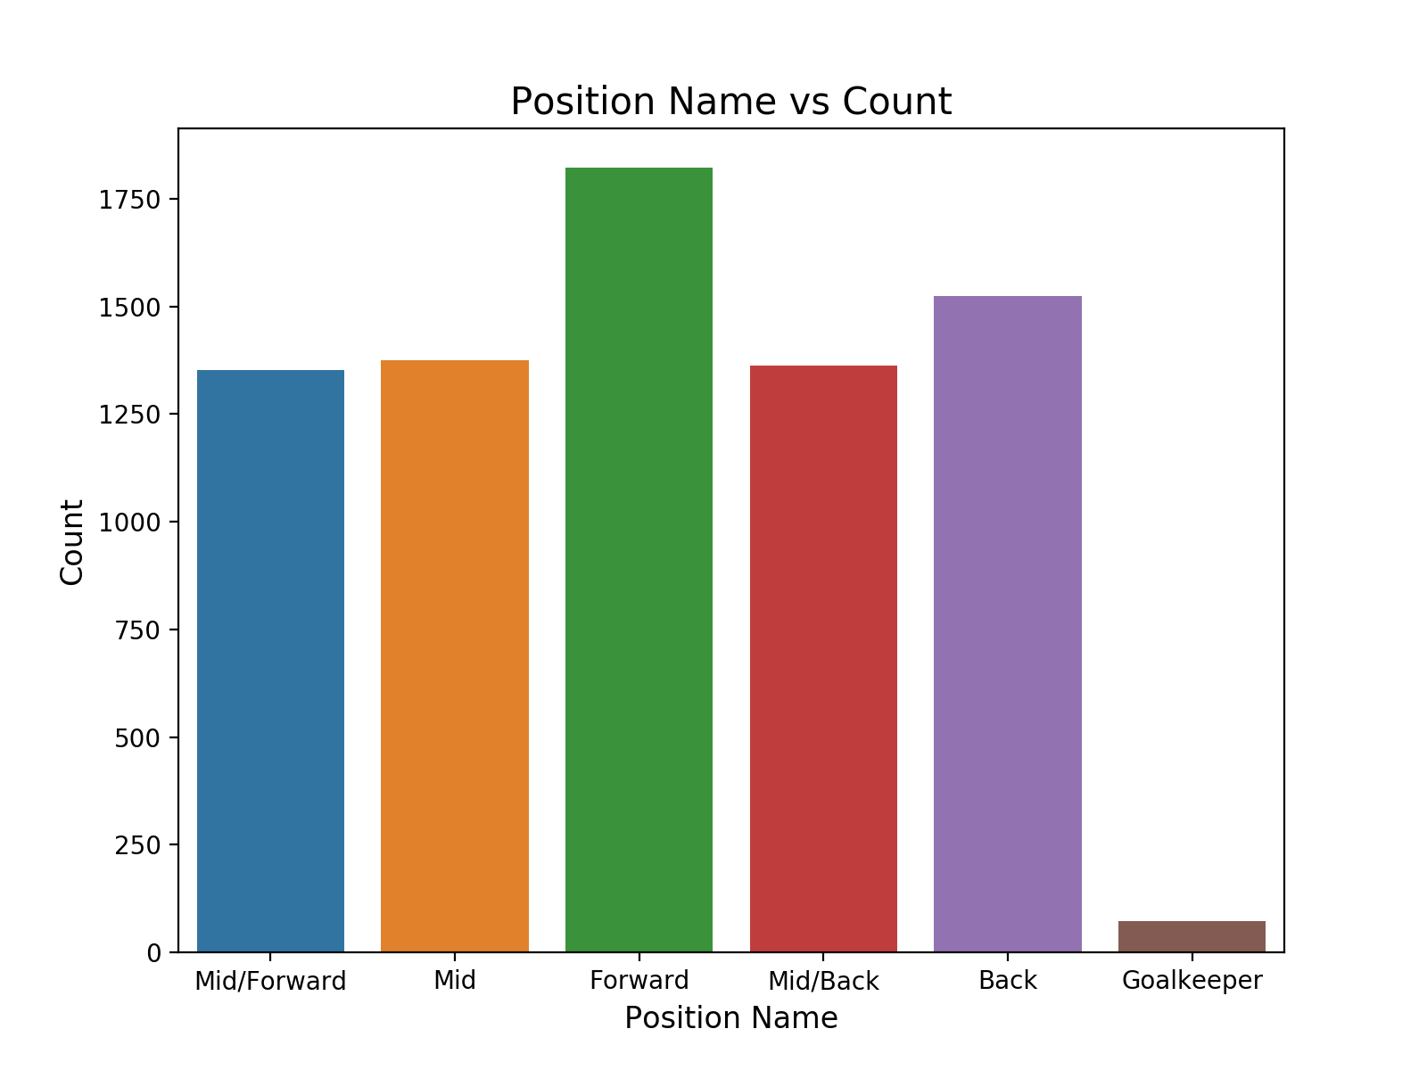
EDA

Slide 8
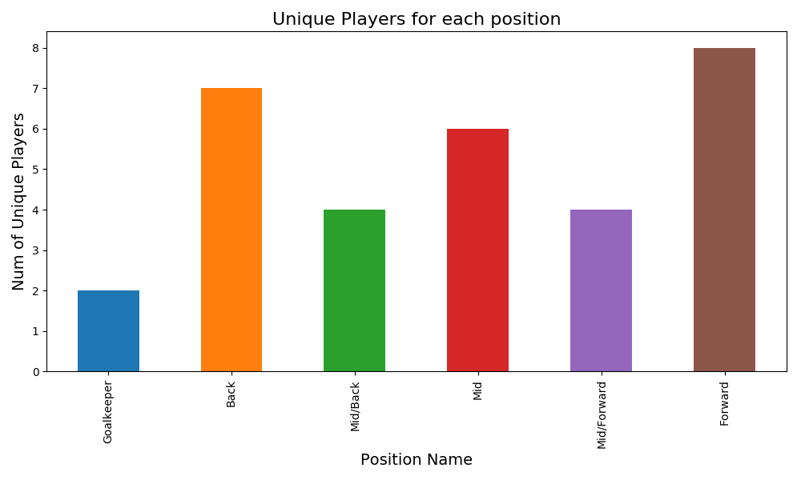

Slide 9
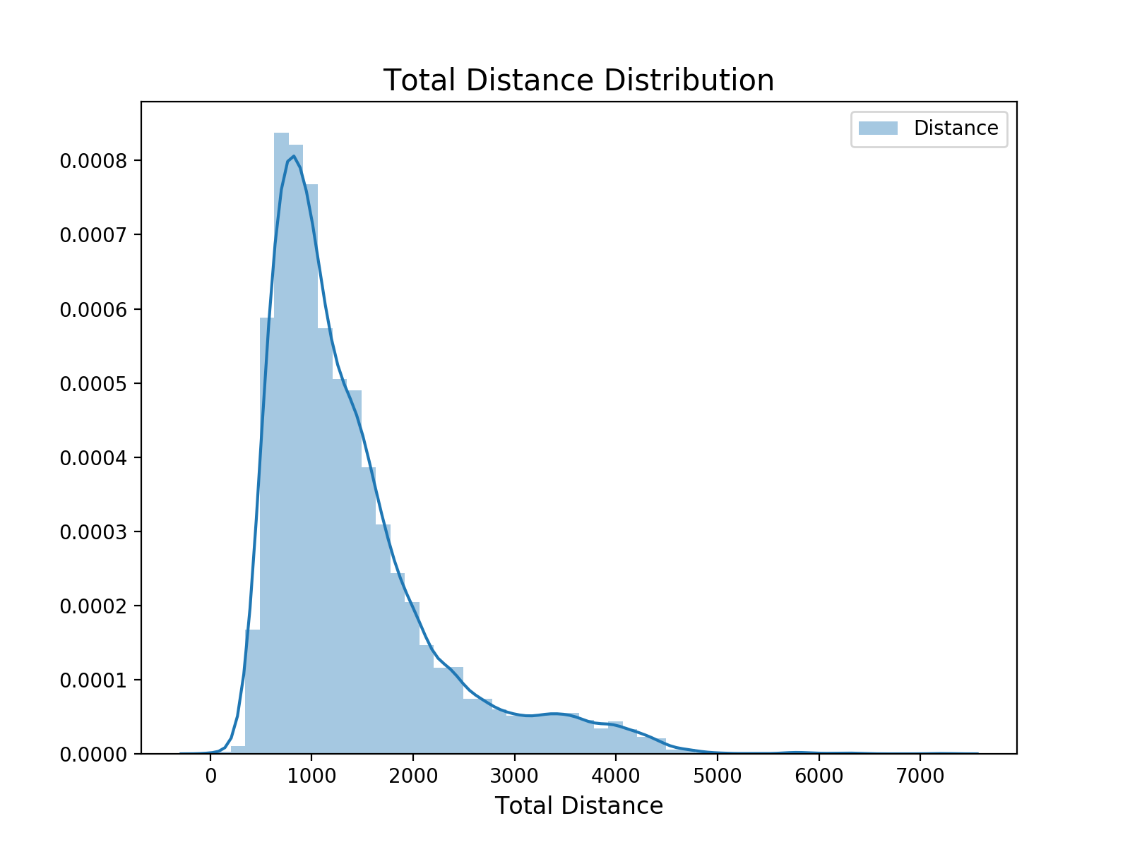
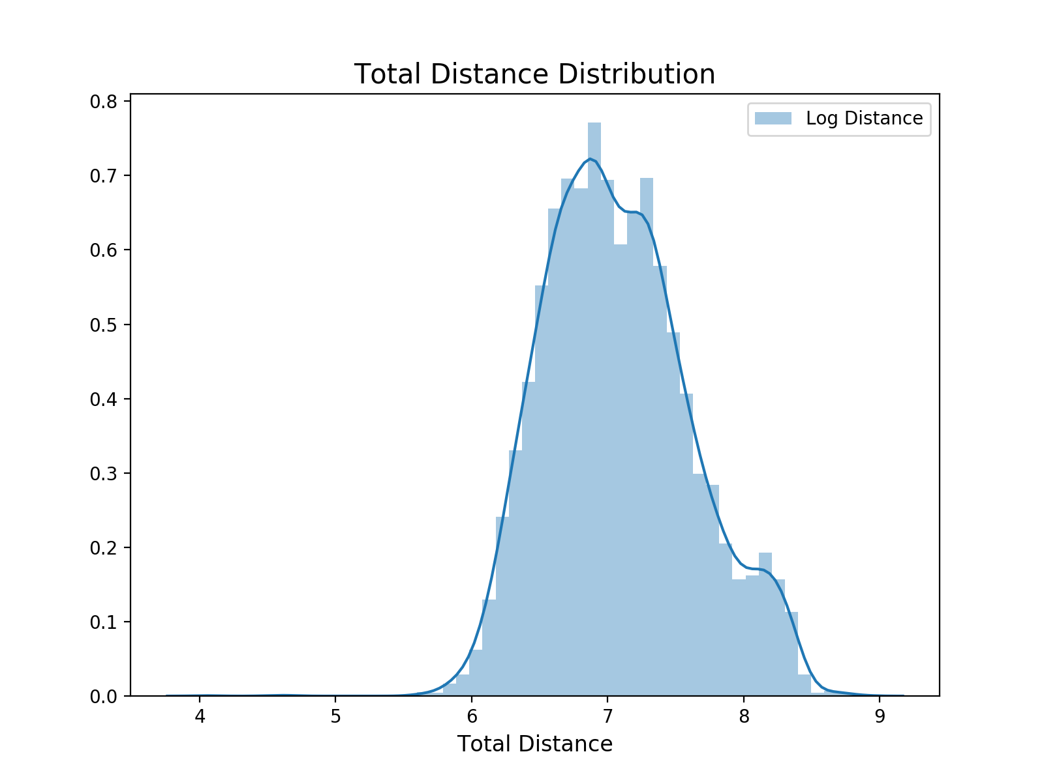

Slide 10
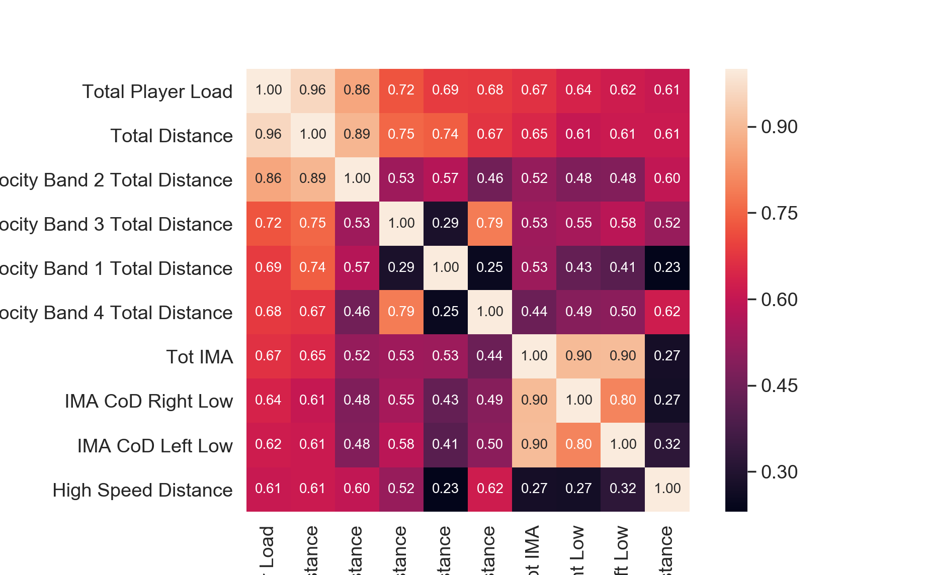

Slide 11
Feature Engineering
Attempt to create new features df['forward_features'] = df['High Speed Distance'] + df['Maximum Velocity'] + df['Velocity Band 5 Total Distance']

Slide 12
Processing
Normalize by players players = df["ID"].unique() for player in players: ids = df[df["ID"] == player].index scaler = MinMaxScaler() df.loc[ids, features_n] = scaler.fit_transform(df.loc[ids, features_n])
LabelEncoder()

Slide 13
Model
Used XGBoost, 27 features
n_estimators=500, learning_rate=0.2 n_estimators=100, learning_rate=0.05 n_estimators=200, learning_rate=0.1
Accuracy of 92.7% with 4,504 of training data

Slide 14
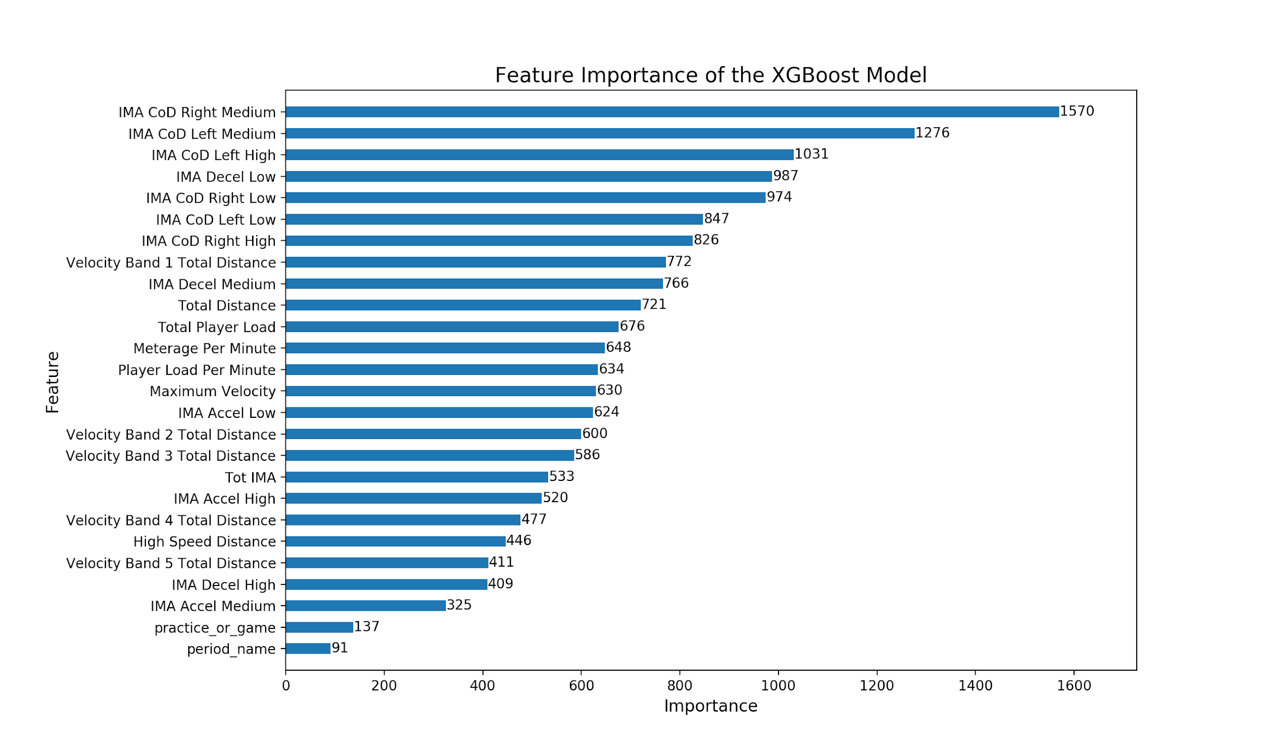
Feature Importance

Slide 15
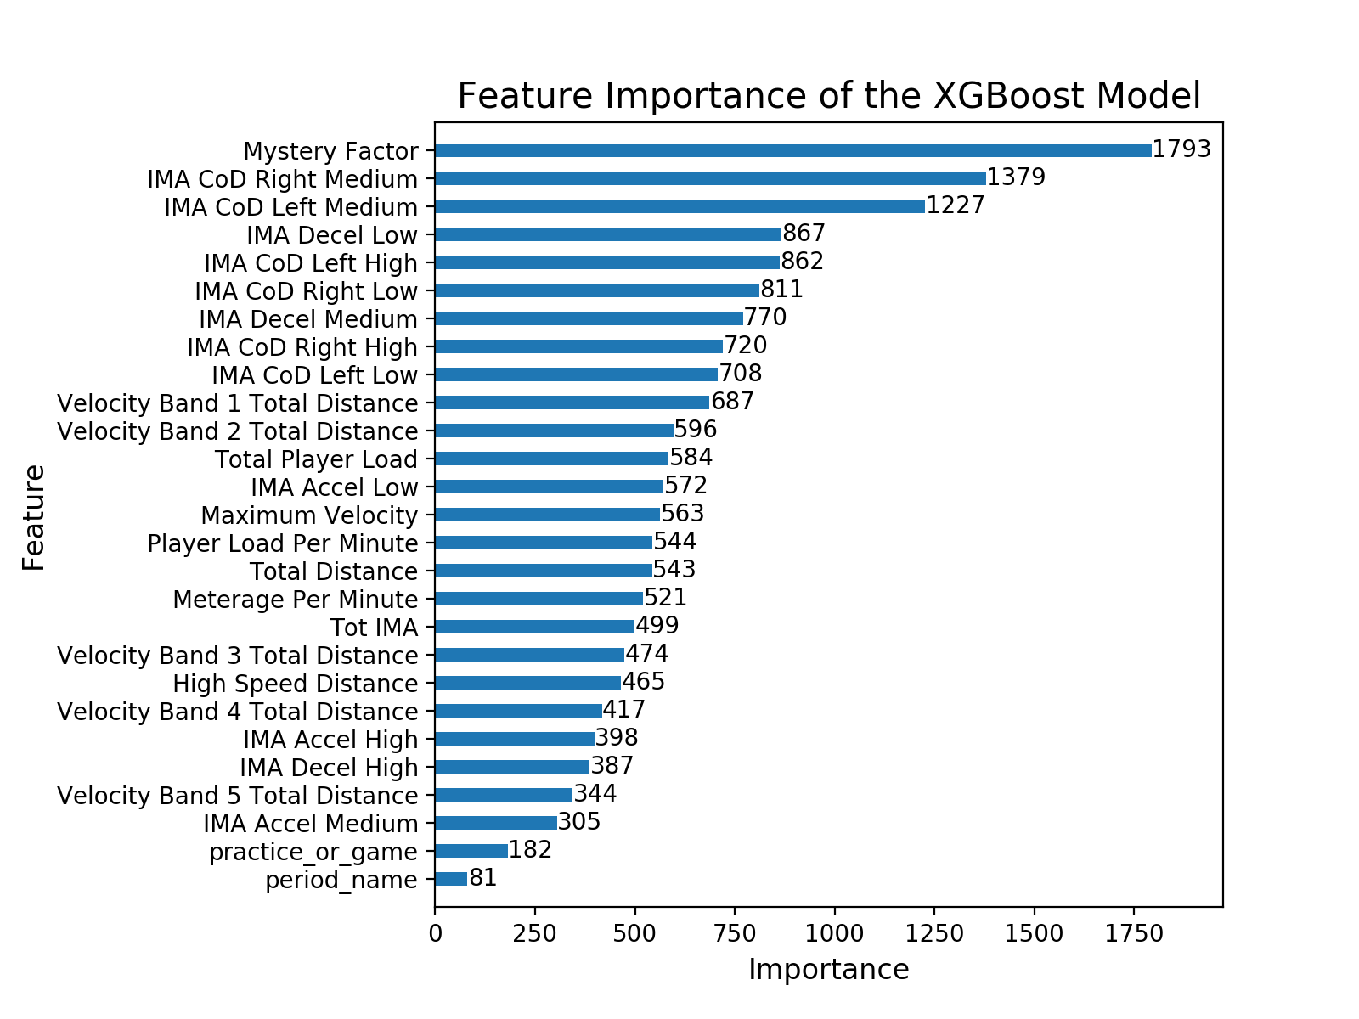

Slide 16
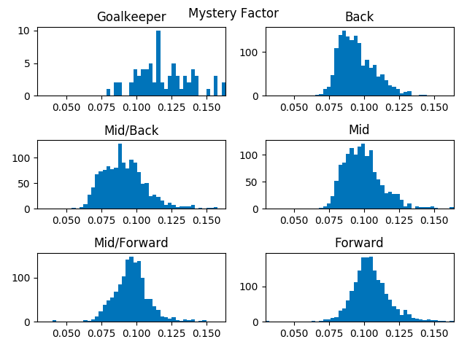
Mystery Factor
df['Mystery Factor'] =
df['Total Player Load'] / df['Total Distance']

Slide 17
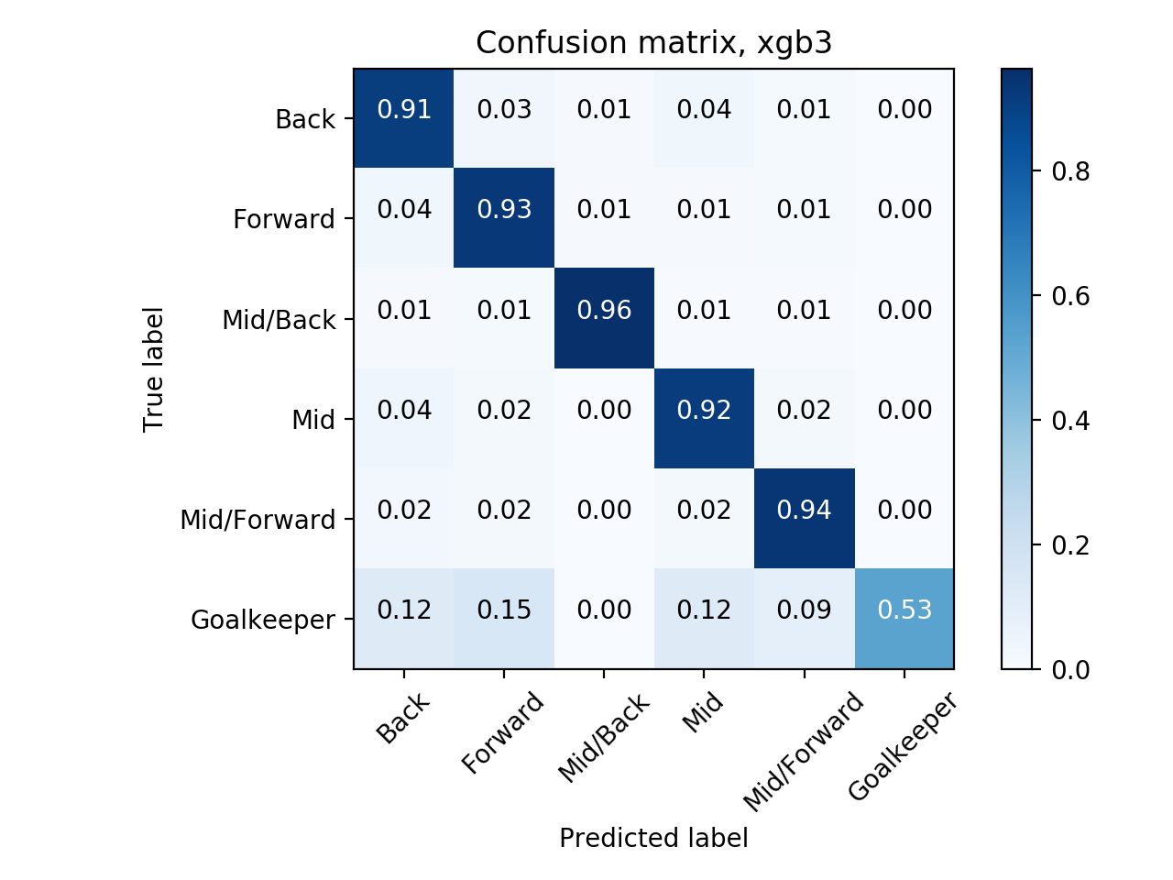
Findings

Slide 18
Conclusion
Initial hypothesis was wrong
Other factors to consider
Heart-rate
Physical Characteristics of Players
Access Historical Performance Data

Slide 19
